Slide 1
Securitisation Risk Assessment
Project:
ZeTheta Data Analyst Project 1
MEENA KARTHIKA

Slide 2
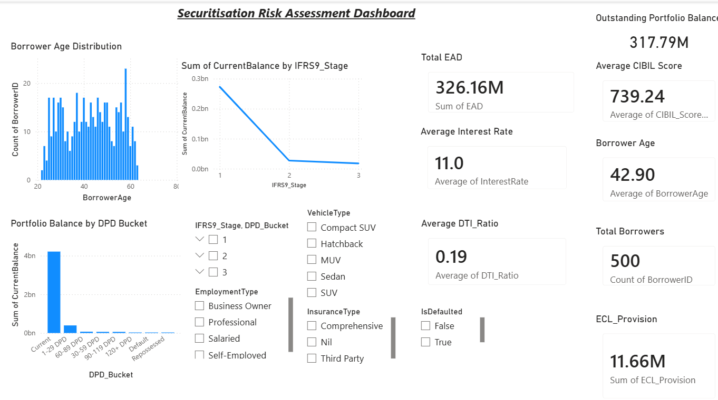
Project Overview
Objective
Build an interactive Power BI dashboard.
Analyze securitization loan portfolio.
Monitor borrower risk.
Evaluate IFRS 9 stages.
Track Expected Credit Loss (ECL).
Provide business insights using DAX.

Slide 3
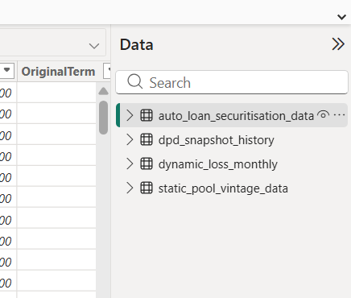
Dataset Overview
Total Borrowers
Loan Details
Current Balance
EAD
CIBIL Score
Interest Rate
DTI Ratio
Employment Type
Vehicle Type
Insurance Type
IFRS Stage
DPD Bucket

Slide 4
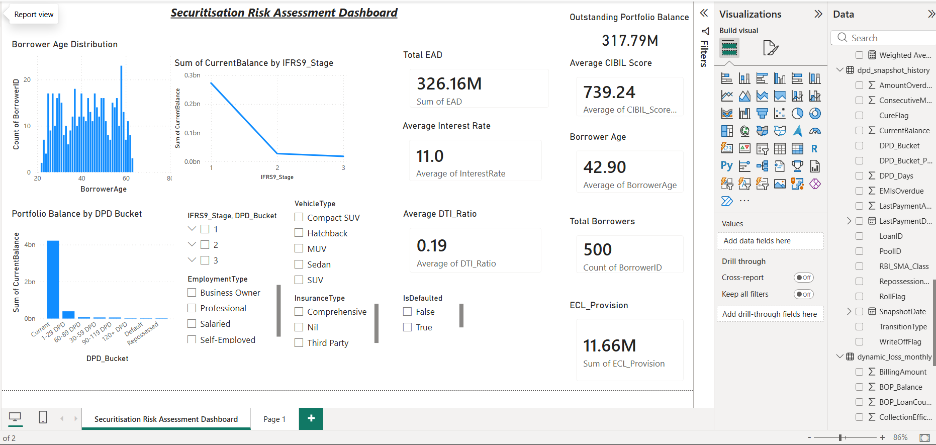
Dashboard Overview
The dashboard provides:
Portfolio Monitoring
Credit Risk Analysis
KPI Monitoring
IFRS Stage Analysis
DPD Analysis
Interactive Filters

Slide 5
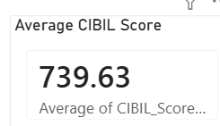
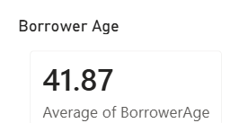
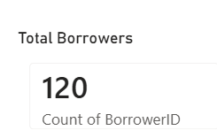

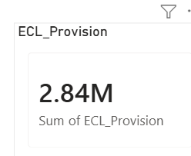
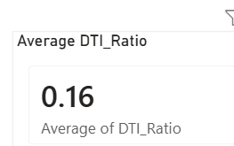
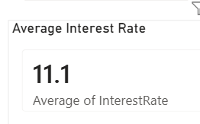
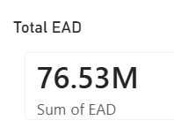
KPI Dashboard
Outstanding Portfolio Balance
Total EAD
Average CIBIL Score
Average Interest Rate
Average DTI Ratio
Total Borrowers
ECL Provision

Slide 6
Outstanding Portfolio Balance
Displays the total outstanding balance of all active loans in the portfolio. This KPI provides an overview of the overall exposure and size of the securitised loan portfolio
Total EAD (Exposure at Default)
Represents the total amount that is exposed to credit risk if borrowers default. It is an important risk metric used in IFRS 9 Expected Credit Loss (ECL) calculations
Average CIBIL Score
Shows the average credit score of all borrowers in the portfolio. A higher average CIBIL score indicates better borrower creditworthiness and a lower probability of default.
Avrage Interest Rate
Represents the average lending interest rate across all loans in the portfolio. This helps analyse portfolio profitability and pricing strategy.
Average DTI (Debt-t-Income) Ratio
Measures the average proportion of a borrower's income used to repay debts. Lower DTI values generally indicate stronger repayment capacity and lower credit risk.
Total Borrower
Displays the total number of borrowers included in the securitisation portfolio. This KPI helps understand the overall size and customer coverage of the portfolio.
ECL (Expected Credit Loss) Provision
Shows the total expected credit loss provision calculated for the loan portfolio. It estimates potential future losses due to borrower defaults and supports IFRS 9 risk assessment and regulatory reporting.
KPI DASHBOARD

Slide 7
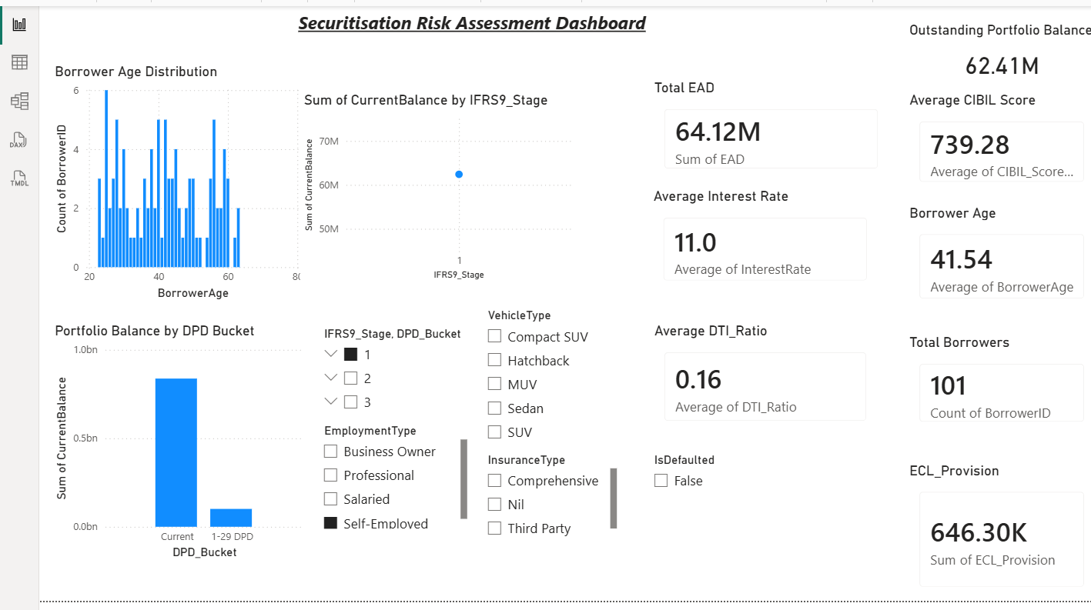
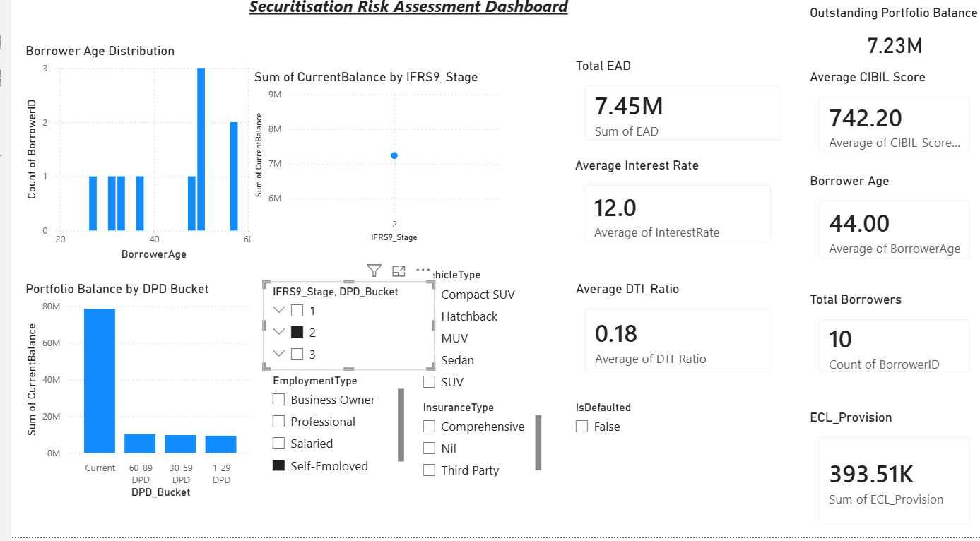
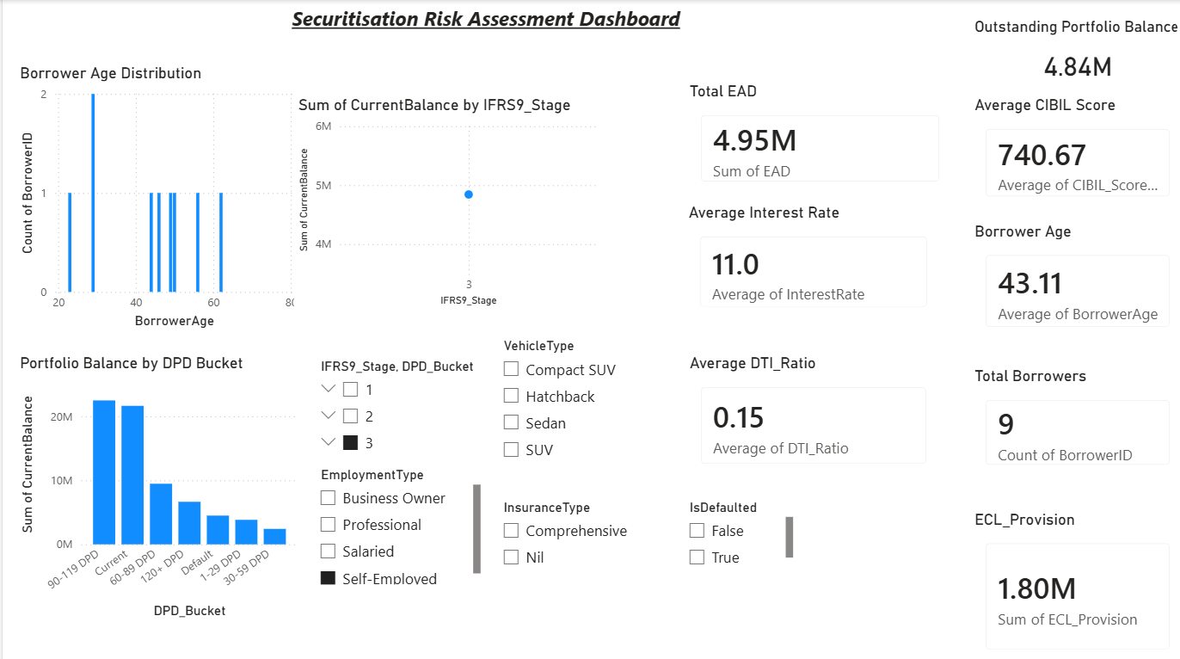
Stage 1
Stage 2
Stage 3
The IFRS 9 Stage segmentation classifies the loan portfolio based on the level of credit risk and borrower repayment performance.
Stage 1: Performing loans with low credit risk and no significant increase in credit risk since origination.
Stage 2: Loans that have experienced a significant increase in credit risk but are not yet credit-impaired.
Stage 3: Credit-impaired or defaulted loans requiring higher Expected Credit Loss (ECL) provisions.
Business Impact:
Enables early identification of high-risk loans.
Supports IFRS 9 regulatory reporting.
Assists banks in estimating Expected Credit Loss (ECL) and monitoring portfolio quality.
Portfolio Risk Analysis

Slide 8
Stage 1
Stage 2
Stage 3
DPD (Days Past Due) Bucket Analysis
The DPD Bucket analysis categorises loans based on payment delays to assess delinquency levels and repayment behaviour.
Current: Payments are up to date.
1–29 Days: Early-stage delinquency.
30–59 Days: Moderate delinquency requiring closer monitoring.
60–89 Days: High credit risk.
90+ Days: Default or severe delinquency requiring immediate action.
Business Impact:
Helps identify delinquent loans.
Supports collection and recovery strategies.
Improves portfolio risk monitoring and credit decision-making.
Portfolio Risk Analysis

Slide 9
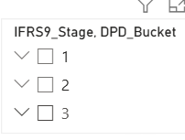
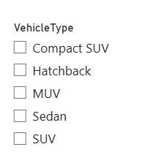
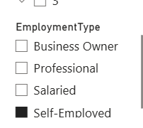
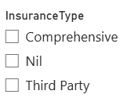
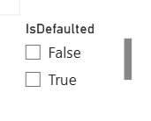
IFRS9 Stage , DPD Bucket
Vehicle Type
Employment Type
Insurance type
Defaulted
INTERACTIVE FILTERING

Slide 10
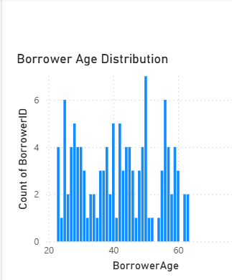
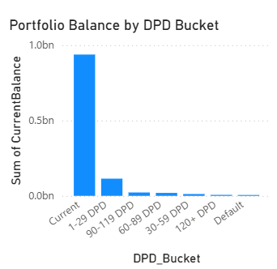
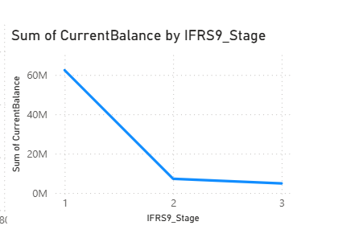
Charts
Borrower Age
IFRS 9 Stage
DPD BUCKET

Slide 11
DAX measures
Measure | Purpose
Total Outstanding Balance | Portfolio Balance
Total EAD | Exposure at Default
Average CIBIL Score | Credit Quality
Average Interest Rate | Lending Analysis
Average DTI Ratio | Debt Burden
Total Borrowers | Portfolio Size
ECL Provision | Expected Credit Loss

Slide 12
1.Majority Of Loans Belong To IFRS Stage 1
2.Current loans dominate the portfolio
3.Higher DPD Buckets Show Increased Credit Risk.
4.Average CIBIL Indicates good borrower quality
5.ECL Identifies Expected Future Losses.
6.Interactive Dashboard Supports Management Decisions.
Business Insights

Slide 13
Conclusion:
1.Built an interactive securitisation dashboard.
2.Implemented IFRS 9 risk monitoring.
3.Created reusable DAX measures.
4.Enabled portfolio risk analysis.
Future Enhancements:
1.Live SAP integration
2.Azure SQL connection
3.Real-time dashboards
4.Machine learning default prediction

Slide 14
Conclusion & Future Enhancements
Conclusion
Built an interactive securitisation dashboard.
Implemented DAX calculations.
Developed KPI cards.
Analysed borrower risk.
Created portfolio risk visualisations.
Future Enhancements
Live SQL Database Integration
SAP Connectivity
Azure Data Pipeline
Machine Learning Default Prediction
Real-time Dashboard Refresh

